Slide 1
Project Of Website Blocker

Slide 2
Group Member Names: 1. Atrooba Afaq 2. Aiman Shayan 3. Azka Shehzad Group Leader Name: 1. Atrooba Afaq

Slide 3
Why we decided this project?
This project was chosen because it addresses a common problem faced by people striving for better productivity and focus in todays digital world. Excessive use of distracting website often hinders people from focusing on important task. By creating a website blocker the aim was to provide a practical solution to this issue enabling users to better manage their online distraction and improve their productivity.

Slide 4
Real life application of this project
A real life application of this website blocker could be in a work place or educational settings where employees or student needs to concentrate on their task without being distracted by social media, gaming or other non work related websites by implementing the website blocker organization can improves productivity and focus among their staff or students by restricting access to distracting websites during work or study hours. This ensures that time spend online is more focused and conducive to achieving goals.

Slide 5
Review about class and Bano Qabil
We have had an amazing learning journey at Bano Qabil. The instructors are incredibly knowledgeable and dedicated to helping students succeed. The hands on approach to learning has boosted my confidence in Python Programming. Bano Qabil provides a supportive environment for collaborative learning.

Slide 6
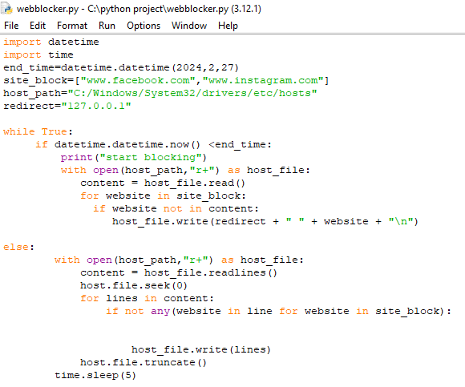
Our Project

